Slide 1
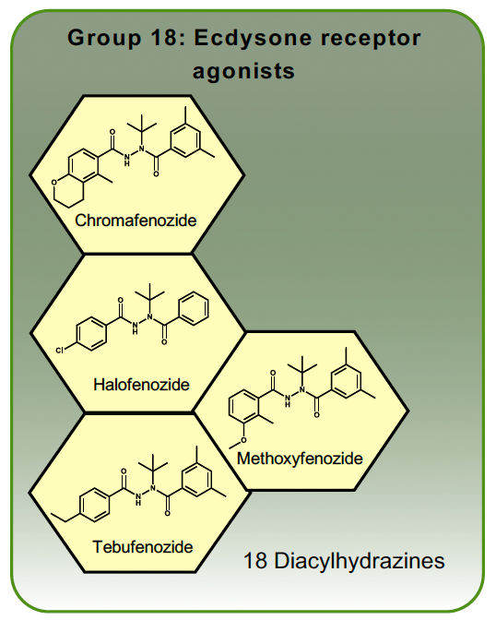
Mode of Action Data Sheets
Group 18 Ecdysone receptor agonists
Mimic the moulting hormone, ecdysone, inducing a precocious moult.

