Slide 1
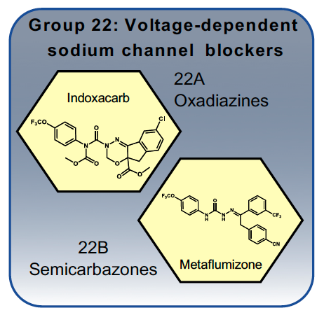
Mode of Action Data Sheets
Group 22 Voltage-dependent sodium channel blockers
Block sodium channels, causing nervous system shutdown and paralysis.
Sodium channels are involved in the propagation of action potentials along nerve axons.

