Slide 1
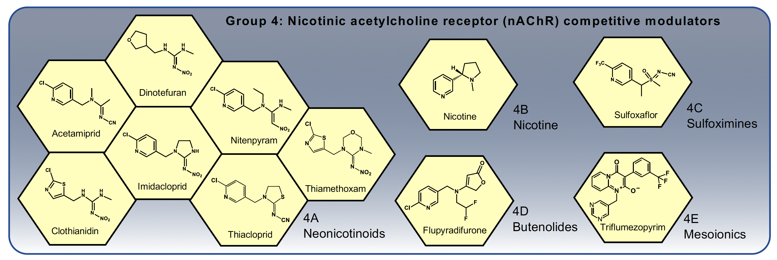
Mode of Action Data Sheets
Group 4 Nicotinic acetylcholine receptor (nAChR) competitive modulators
Bind to the acetylcholine site on nAChRs, causing a range of symptoms from hyper-excitation to lethargy and paralysis. Acetylcholine is the major excitatory neurotransmitter in the insect central nervous system.

