Slide 1
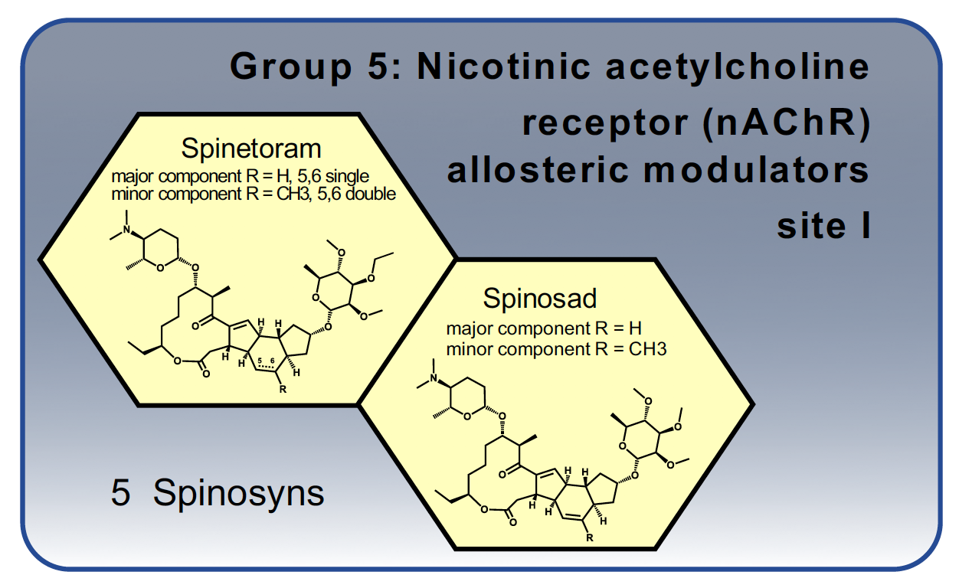
Mode of Action Data Sheets
Group 5 Nicotinic acetylcholine receptor (nAChR) allosteric modulators – Site 1
Allosterically activate nAChRs (at a site distinct from Group 32 - Site II) causing hyperexcitation of the nervous system. Acetylcholine is the major excitatory neurotransmitter in the insect central nervous system.

